Slide 1
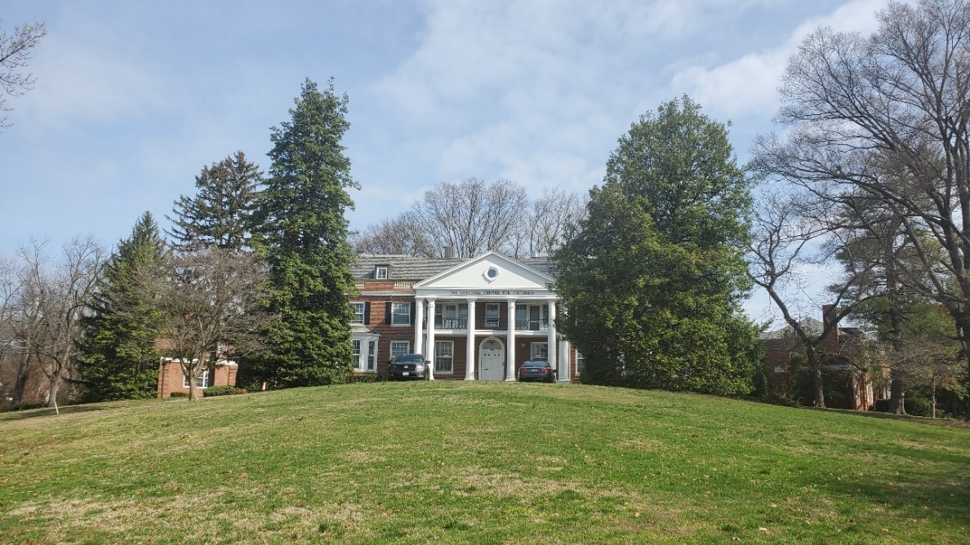
The Episcopal Home for Children 5901 Utah Avenue, NW
Historic Preservation Review Board Presentation:
February 25, 2021

Slide 2
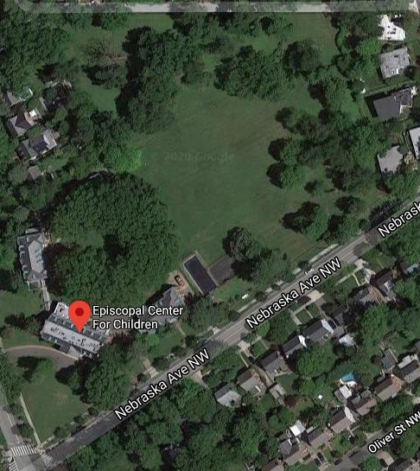
The Site: The Episcopal Home for Children is in the Chevy Chase / Barnaby Woods neighborhoods of the District of Columbia in Ward 4. The site has frontage on two streets and is bounded to the east by Nebraska Avenue, NW, on the west by Utah Avenue, NW, and to the north and west by a public alley. Single family homes are located adjacent to the east and north west property lines with additional single-family homes located to the north beyond the public alley.
Development: What had originally been a series of large parcels of land often with country homes was transformed over the coming years as a result of the relentless growth of the District, with the notable change occurring in 1931 with Nebraska Avenue, NW having been cut through.

Slide 3
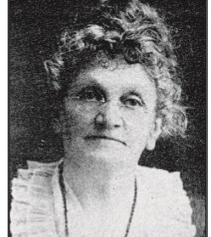
The History: “Since 1894, the Episcopal Center for Children has been a way station for children facing challenges” The history of the Home has its roots in the efforts of the Reverend William Goss Davenport and his wife Mary Davenport in the 1890’s to seek to address the needs of the nation’s underserved children. What began as the Bell Home for Poor Children, the Home would see its mission evolve from a convalescent home for children to an orphanage, and then to providing care for emotionally challenged children. begins in the 1890’s with the efforts of the Reverend Willard Goss
Mary Davenport: A pioneering figure in the Episcopal Church through her membership in the Order of the Daughters of the King, Mary sought to empower young women with the establishment of the “Junior Daughters”.

Slide 4
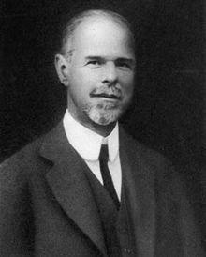
The Individuals: “He said that he did not care to have any publicity at this time” In addition to the work of the Davenport’s, the history of the Home is reflective of the combined efforts of individuals who shared their belief in the importance of providing a place for children that could meet their unmet needs. Among the figures involved in this effort was Mr. Edwin Gould of New York City where he had led the effort to establish the notable Sheltering Arms Children’s Services. Gould provided the funding for the Home to purchase the nine-acre site for the campus and would continue to support the Home with additional funding for its development.
Alexander Melville Bell: A critical early benefactor, Bell was the father of Alexander Graham Bell, and notable in his own right for his work in the education of deaf persons. His gift of land in Colonial Beach, Virginia led to the establishment of the original summer home for children.

Slide 5
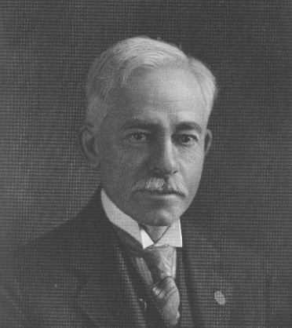
The Architect: “In his obituary, the Washington Post deemed Appleton P. Clark the “Dean of Architects.” Architect Appleton P. Clark’s involvement with the Home reflected his deep commitment to the national effort, and in particular within the District, to promote the welfare of children. Clark served as President and Director of the Washington Sanitary Housing Company which was responsible for the construction of affordable housing for low-income residents.
Appleton P. Clark: Clark’s work spanned the last decade of the 19th and first half of the 20th Centuries and was notable for the breadth of the styles and sizes ranging from private homes, to commercial buildings and apartment houses, as well as campuses. He was responsible for the design of over 900 buildings, often in the Classical Revival Style.

Slide 6
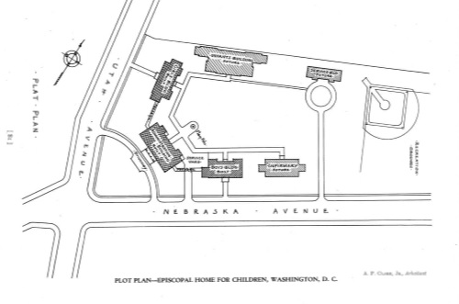
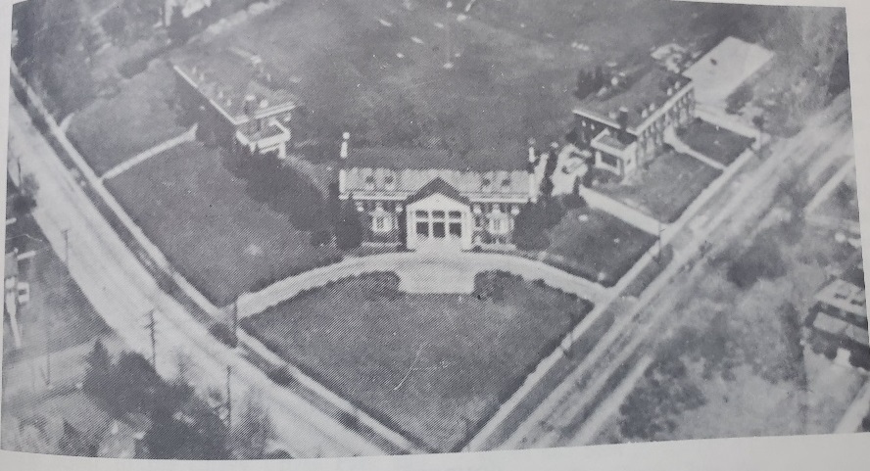
The Plan: Clark’s plan for the Home reflected the core set of principles that he had established for how “modern” campuses should be designed for children’s homes. At the same time, Clark recognized the importance of having it be a compatible neighbor with the single-family homes that had come to define the area. The design sought to create a campus with the modestly scaled two-story buildings grouped around a central yard / plaza. The siting of the buildings took advantage of the natural topography and were planned to reinforce the residential feel of the design.
Details: “I would not have white paint in the dining room under any conditions, it is in my opinion impractical.”
Clark was intimately involved with all aspects of the design of the Home including the choice and ordering of the furniture as well as the finishes, including the paint colors.

Slide 7
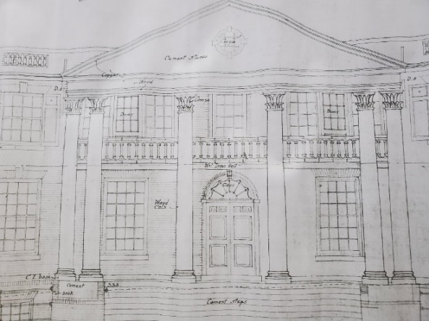
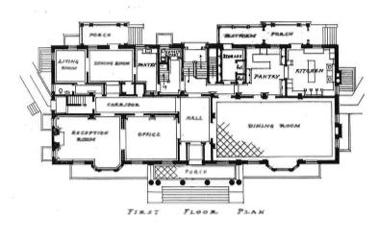
The Architecture: The buildings that make up the campus of the Home reflect architect Clark’s proficiency with the design of buildings in the Classical Revival Style, and in this case with strong Georgian and Colonial influences. Notable details including porches and pediments supported by columns, projecting bays, decorative stonework, dormer windows, and richly expressed chimneys at the side elevations. Clark’s design also sought to address safety concerns for a children’s home, with all of the buildings be constructed of concrete, brick, and terra cotta, making them fireproof.
Floor Plans: Clark recognized the importance of the layouts of the building providing the children and staff with healthy spaces for both living and learning. His design allowed for generous ceiling heights and multiple windows for light and air, as well as common areas for study and indoor play.

Slide 8
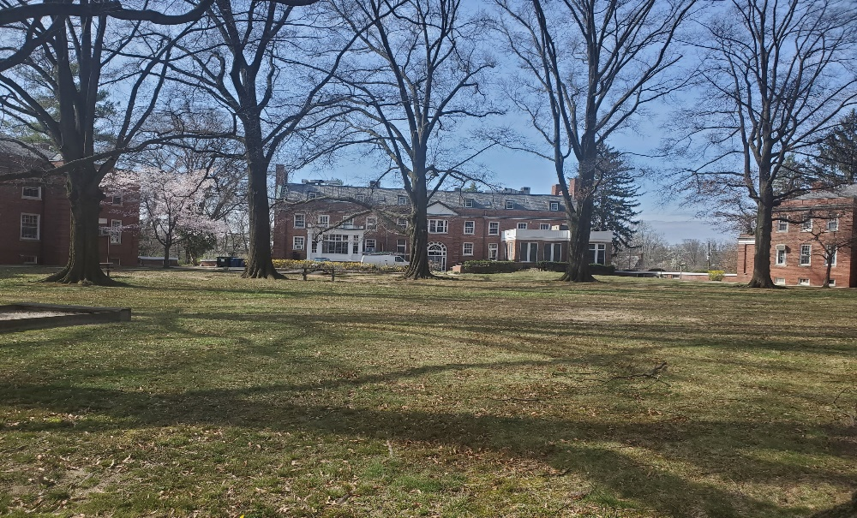
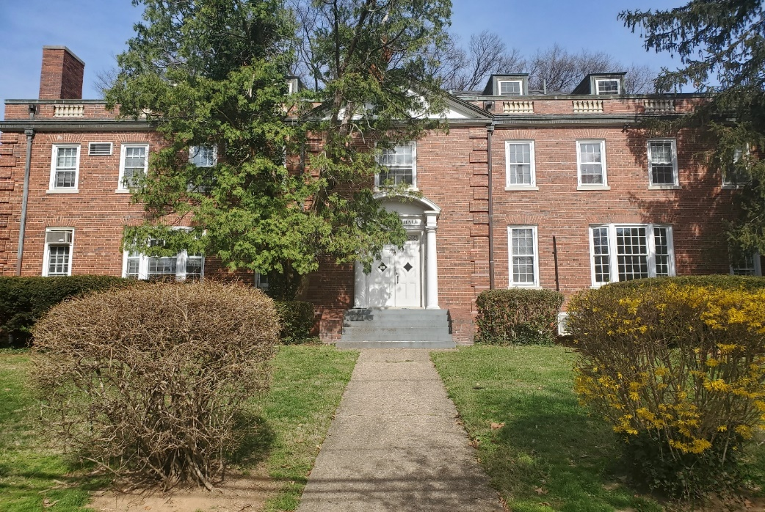
The Landscape: The focal point of the landscape plan was the central yard / plaza around which the three main buildings were grouped. The plan for this important space consisted of an open lawn area ringed by mature / specimen trees in order to help define it as well as to provide shade for its use during the warm months. The landscape plan was intentionally designed to be simple to allow for its active use and limit the amount of expense needed for its upkeep. The large open lawn area was designed for use as athletic fields with buffering from the adjacent properties provided by the planting of trees at the perimeter.
Plantings: Clark sought to minimize the visual impact of the buildings on the residential streets through the use of a more robust planting plan consisting of the use of hedges, and holly and evergreen trees.

Slide 9
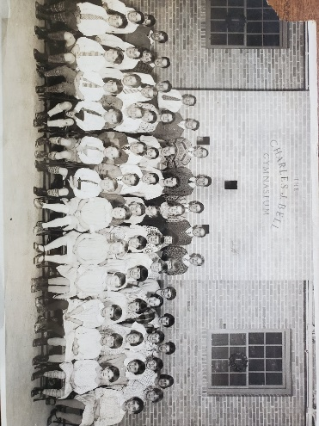
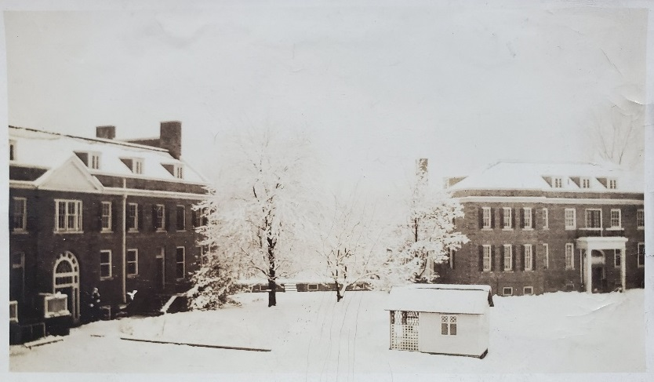
Statement of Significance: The Progressive Era saw the attempt to address a number of critical issues facing the nation, including the care and treatment of children. The Home is significant under National Register Criterion A as an example of the nationwide movement that sought to improve the care of vulnerable children through the establishment of institutions. The Home is also significant under National Register Criterion C for being both a notable example of the design of a children’s home and the work of a recognized master in the field of architecture, Appleton P. Clark.
Clark’s Vision: Clark had a deep interest in the design of institutional campuses, with the goal to “create a collection of institutional buildings that did not look institutional”, which he articulated in his book Institutional Homes for Children, 1945.

Slide 10
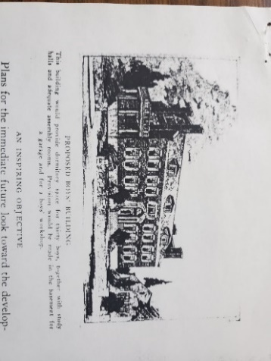
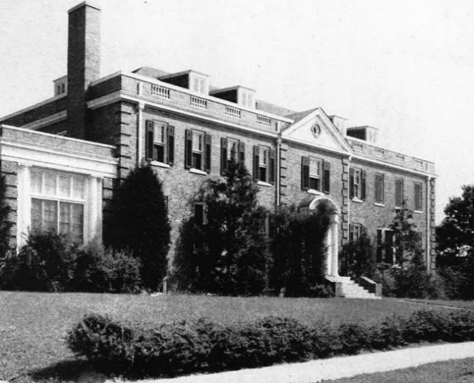
Period of Significance: The proposed Period Of Significance is the year 1929 which is when Clark’s vision for the Home was realized with the construction of the campus and three main buildings. The Home has had a notable history over the following eight decades during which there were major changes to the programming and functions, however, Clark’s plan for the site was left remarkably intact. Later alterations and new construction do not have the same level of significance, with the defining period being Clark’s design and the construction of the Home.
Connections: Clark’s design recognized the critical importance of the campus being truly functional and sought to address this by seeing that the plan allowed for the three main buildings to be linked, which he accomplished with enclosed passages / corridors at the basement level.

Slide 11
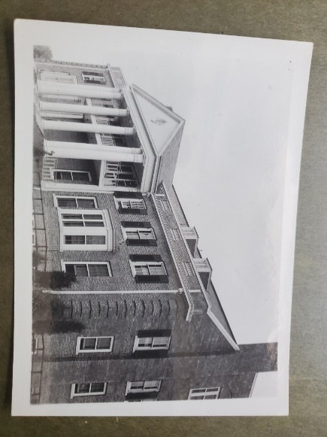
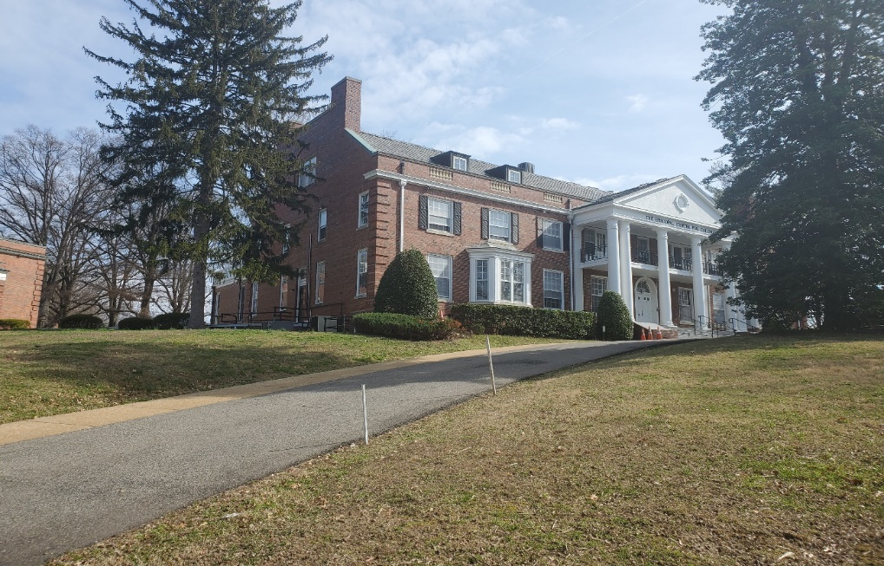
Integrity: Some ninety plus years after its construction, the Home has retained sufficient integrity for significance under Criteria A and C. The Administration Building is intact on its primary elevations, front and sides, with the only notable alteration consisting of a compatible one-story addition at the rear. For the Girls’ and Boys’ Buildings, the only notable alteration was to the Girls’ Building consisting of a compatible one-story addition on the side (south) elevation. All three buildings have retained their character-defining exterior architectural details.
Interiors: In addition to the largely intact exteriors, the Home is notable for the remarkable amount of intact original finishes on the interior that include woodwork, plasterwork, and tilework. Additional features include the distinctive wood storage lockers that Clark designed.

Slide 12
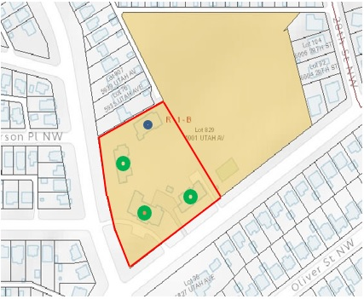
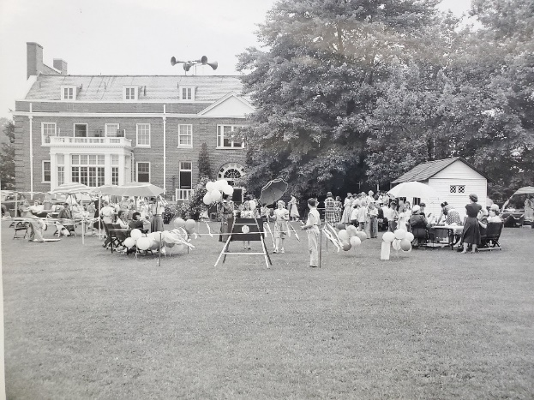
Boundary Justification: The proposed boundary encompasses the three historic (Contributing) buildings designed by Clark as well as the central yard / plaza that is the focal point of Clark’s design for the campus. In addition, the later (Non-Contributing) Libaray / Media Center Building is included as it serves to define this character-defining space. Clark’s original plan for the Home was more expansive, but was not fully realized, and as such designating this core area that reflects Clark’s vision is appropriate and in-keeping with the guidance found in the National Register Bulletin – Defining Boundaries for National Register Properties.
Costs: Clark’s plan proposed the construction of a total of six buildings on the campus which he estimated would cost $323,000, however, only three of the buildings were constructed as a result of both funding issues and changes to the programming and functions of the Home.

Slide 13
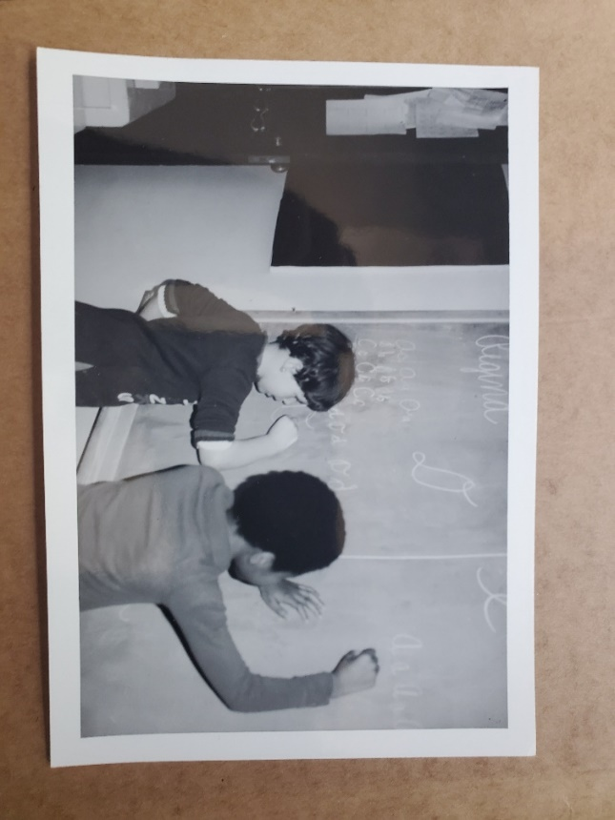
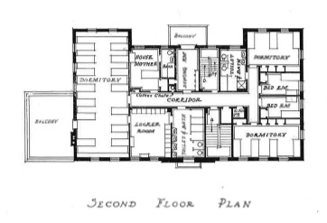
Conclusion: “the improved pleasant surroundings in which the children are placed when compared with some of the old so called “orphan asylums” of the past” The Home is representative of the national movement for the establishment of “modern” facilities for children’s homes that sought to create campus like spaces to improve the residential and educational care provided. The Home reflects the growth of the services provided to underserved children during a period of increased need. The Home is an important example of the work of Clark, and of his work on the design of campuses.
Integration: The Home addressed the need to fully live up to its mission in 1960 with the amendment to the 1908 certificate of incorporation in order to remove the charter restriction limiting the service of the institution to only white children.

Slide 14
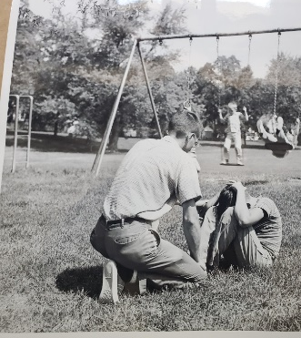
The Episcopal Home for Children
We Believe
Every Child
Can

