Slide 1
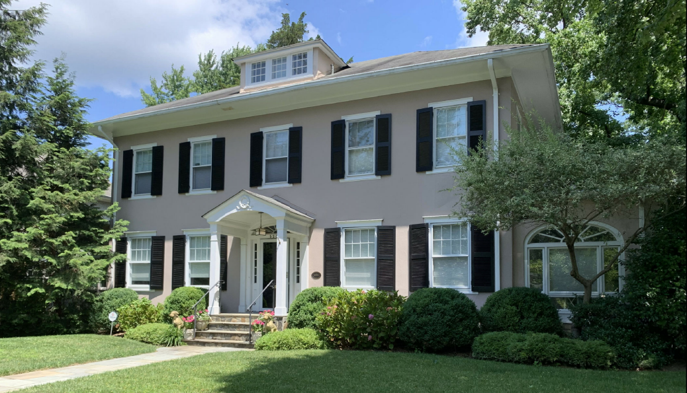
BZA Case No. 21069 Property: 5207 38th Street NW Applicant: Charles Cadwell and Mary Schapiro

Slide 2
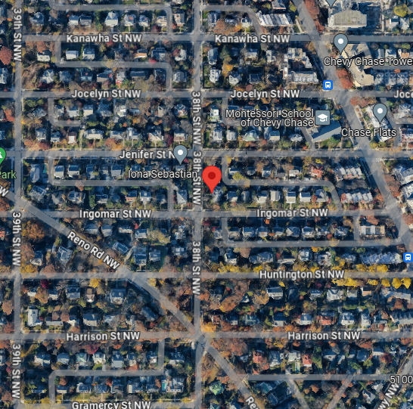
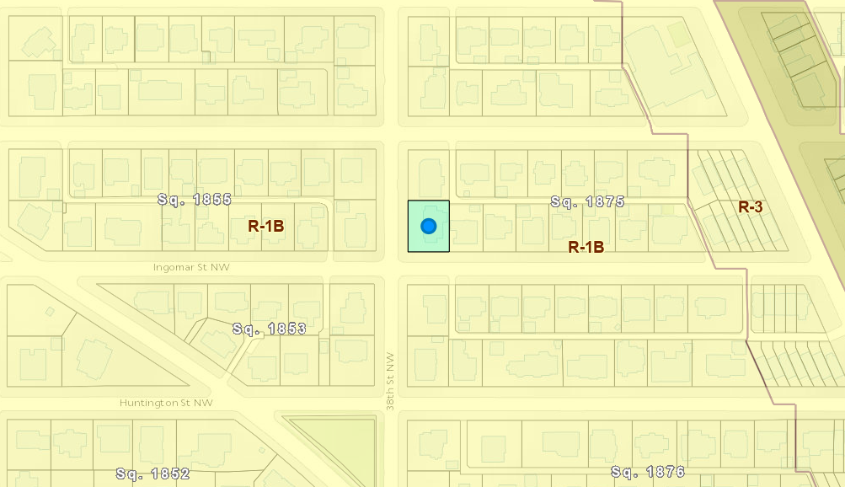
The Property – R-1B Zone

Slide 3
Project Summary
Addition of two-story elevator with one-story covered porch at northeast side of home
Project dimensions are 11’2” x 19’ and within footprint of existing porch
Zoning relief for rear yard
Existing, non-conforming rear yard of 4.2 ft. is being extended
Letters of support from both adjoining neighbors
5209 38th Street NW (Murthy/Riley)
3725 Ingomar Street NW (Winkle)

Slide 4
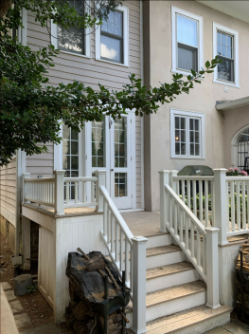
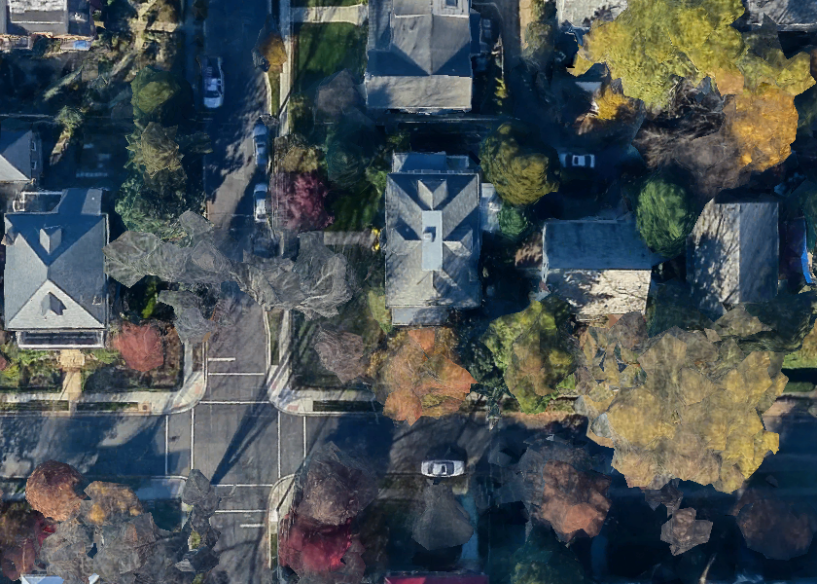
Existing Home – Area of Work

Slide 5
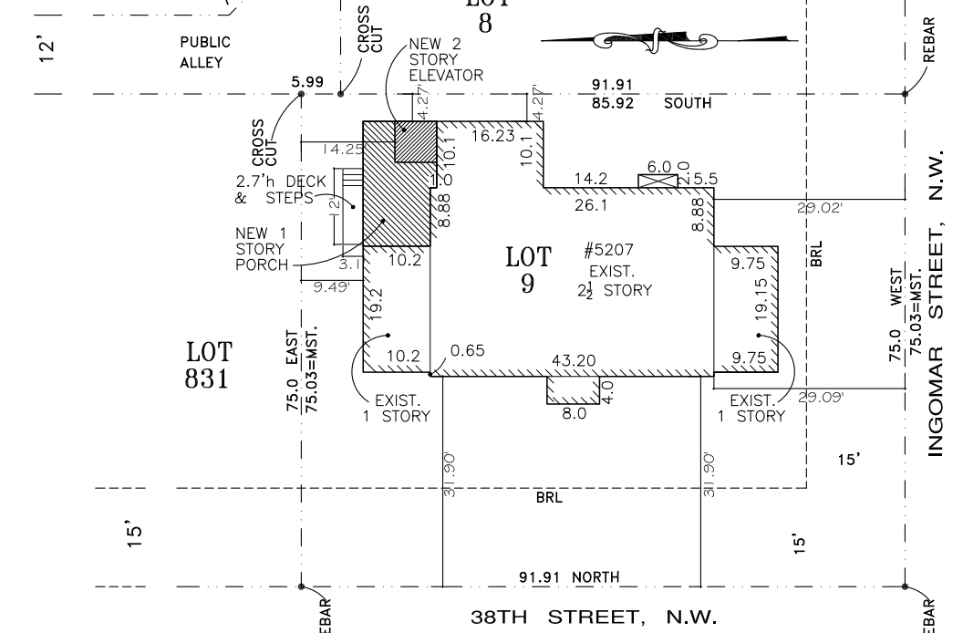
Site Plan

Slide 6
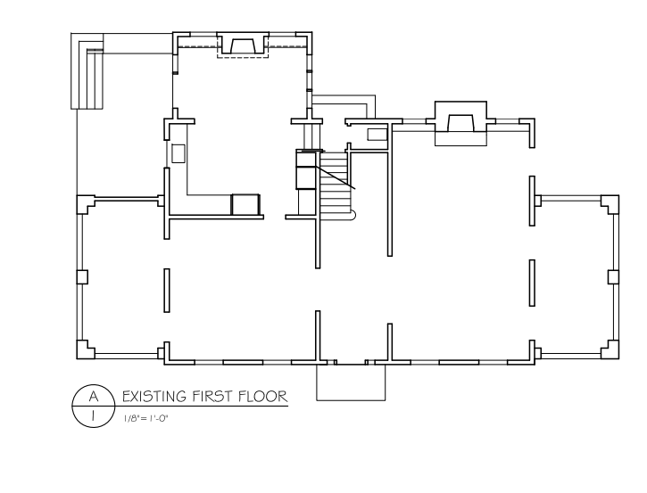
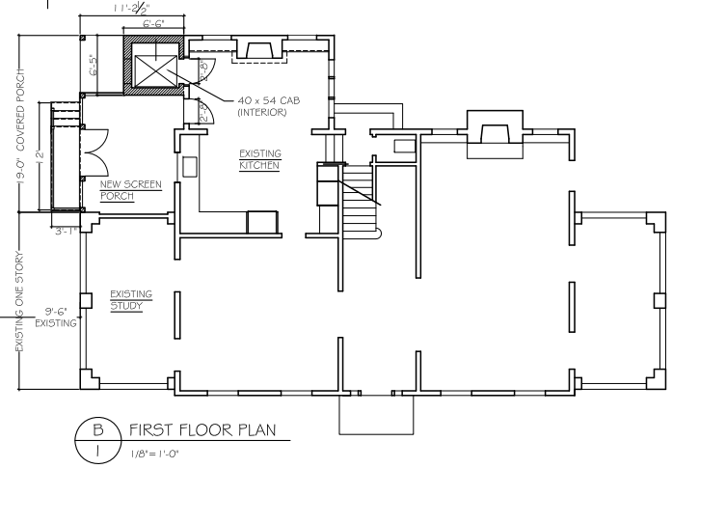
First Level
Existing
Proposed

Slide 7
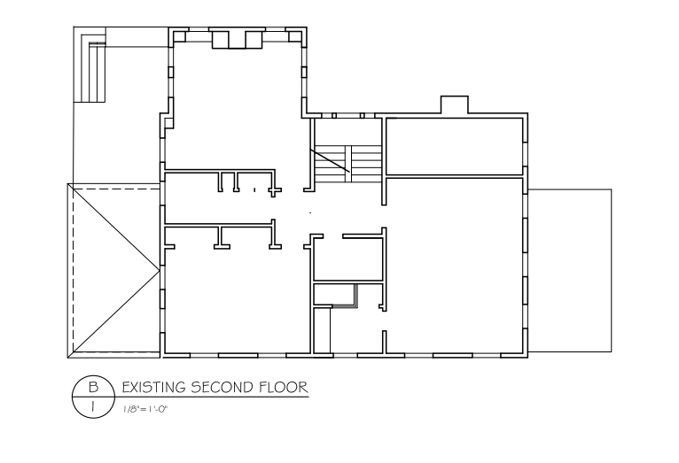
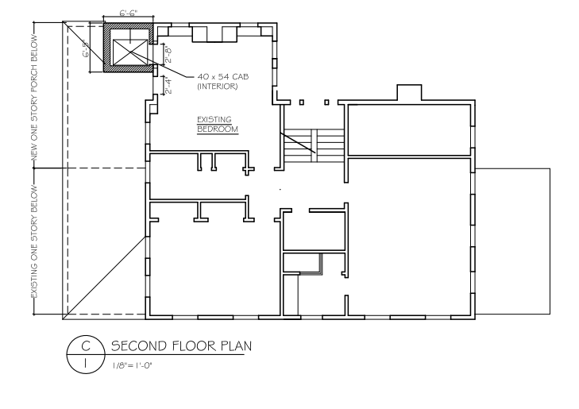
Second Level
Existing
Proposed

Slide 8
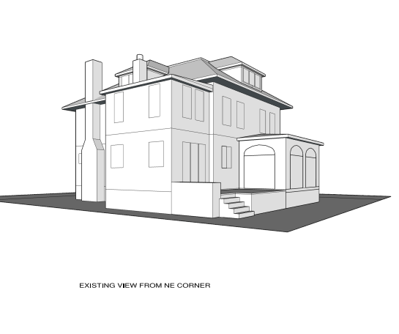
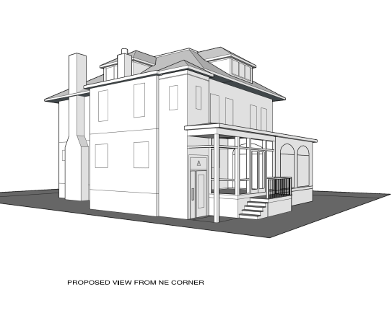
Perspective
Existing
Proposed

Slide 9
BZA Case 21069
Special Exception Relief
Rear Yard
Existing – 4.2 ft.
Required – 25 ft.
Proposed – 4.2 ft.
Hearing scheduled for March 20, 2024

